Slide 1
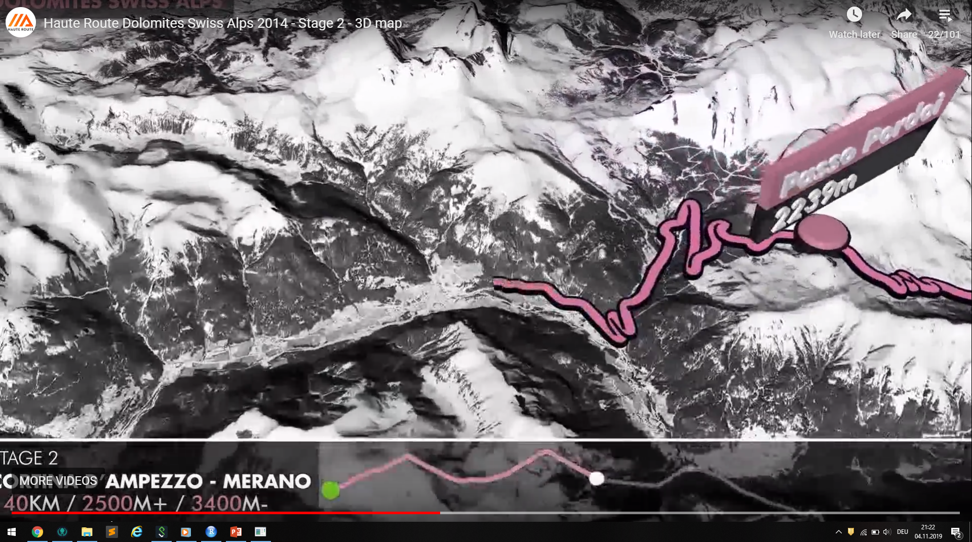

Slide 2
Cycling Tour - Schliersee Tegernsee

Slide 3
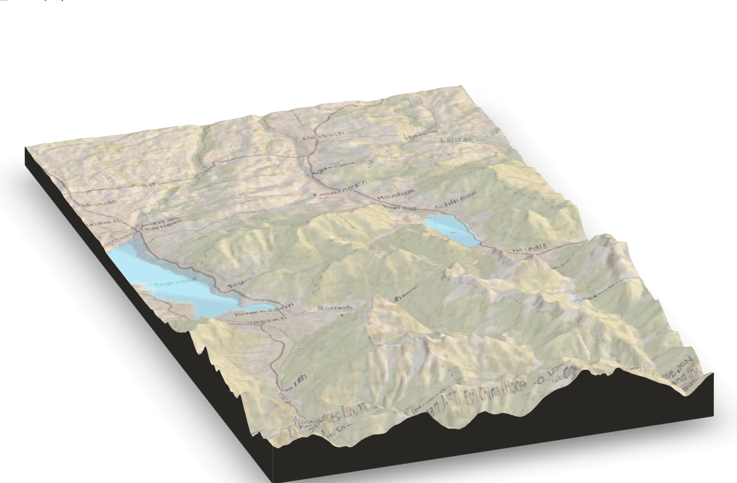
Cycling Tour - Schliersee Tegernsee
Start

Slide 4
Start in Bernlohe
Start

Slide 5
Start

Slide 6
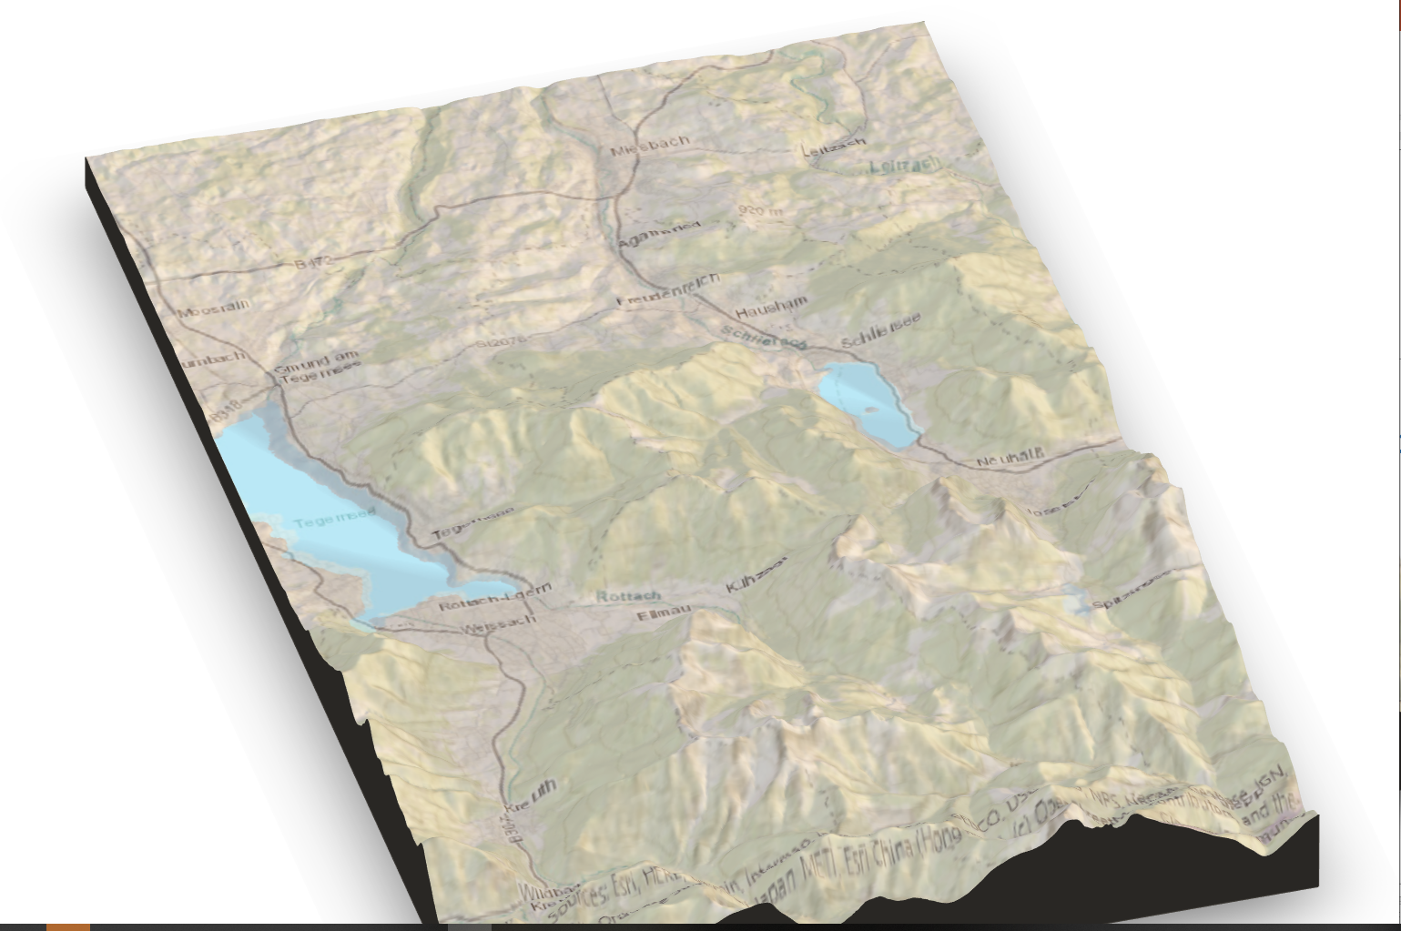
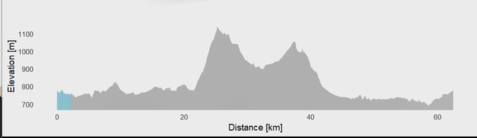
Start
Dist: 0 km Elev: 619 m Time: 11:00 h

Slide 7
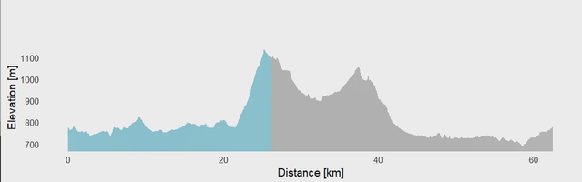
Highest Peak - Spitzingseesattel
Start
Spitzingseesattel 1119m
Dist: 25 km Elev: 1119 m Time: 12:00 h

Slide 8
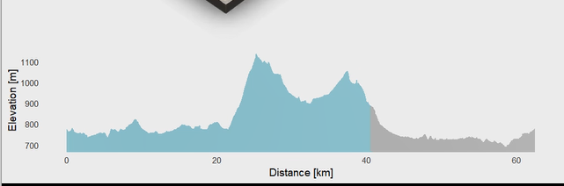
Start
Spitzingseesattel 1119m
Dist: 45 km Elev: 719 m Time: 12:30 h

Slide 9
Start
Schliersee
Spitzingseesattel 1119m
Cafepause Tegernsee

Slide 10
